Slide 1
SMART HOME ENERGY ADVISOR agent
IBM AICTE PROJECT
Presented By: Rahul Sutradhar
Student name : Rahul Sutradhar
College Name & Department : University of Engineering and Management, Kolkata
Electronics and Communication Engineering

Slide 2
OUTLINE
Problem Statement
Technology used
Wow factor
End users
Result
Conclusion
Git-hub Link
Future scope
IBM Certifications

Slide 3
Problem Statement
Electricity bills often present raw consumption data without contextual insights, making it difficult for households to identify inefficiencies or implement effective energy-saving strategies. This project proposes an AI-powered advisory agent that interprets billing data, analyzes usage patterns, and provides tailored recommendations to help users optimize energy consumption and reduce costs.
Proposed Solution: This project develops an intelligent AI-powered agent capable of interpreting electricity bills, identifying consumption inefficiencies, and delivering personalized recommendations. Using semantic analysis, historical data trends, and goal-driven feedback loops, the agent guides users toward optimized energy usage and cost savings. The solution is scalable via IBM Cloud and designed to evolve through adaptive learning and smart integrations.

Slide 4
Technology used
IBM cloud lite services
Natural Language Processing (NLP)
Retrieval Augmented Generation (RAG)
IBM Granite model
Big Data Analysis

Slide 5
IBM cloud services used
IBM Cloud Watsonx AI Studio
IBM Cloud Watsonx AI runtime
IBM Cloud Agent Lab
IBM Granite foundation model

Slide 6
Wow factors
This AI agent redefines energy advisory systems by infusing intelligence, adaptability, and cloud scalability into everyday billing data. It doesn’t just analyze consumption—it anticipates user goals, learns from patterns, and delivers precision-driven insights. The result: a dynamic shift from passive data review to active energy intelligence, making households smarter, greener, and more cost-conscious.

Slide 7
End users
Residential Homeowners
Tenants in Smart Apartments
Energy Researchers or Policy Analysts
Tech-savvy Individuals
Eco-conscious Consumers

Slide 8
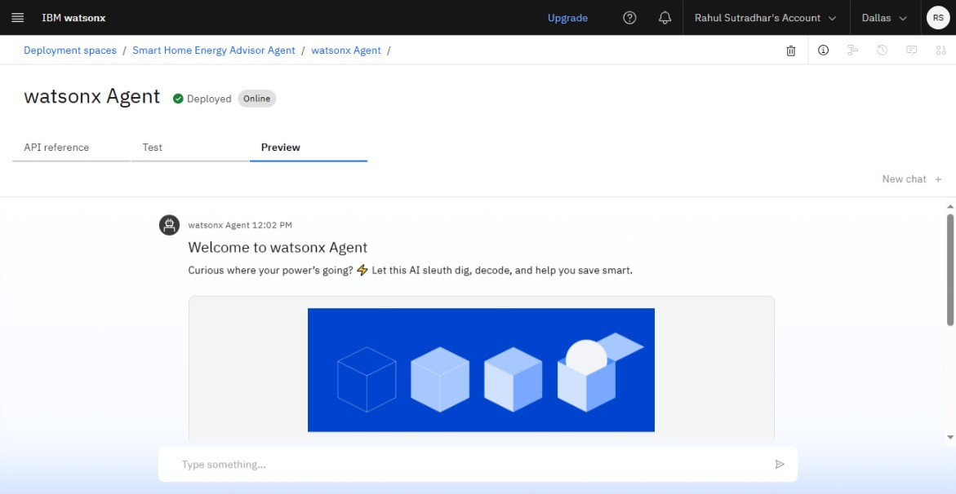
Results

Slide 9
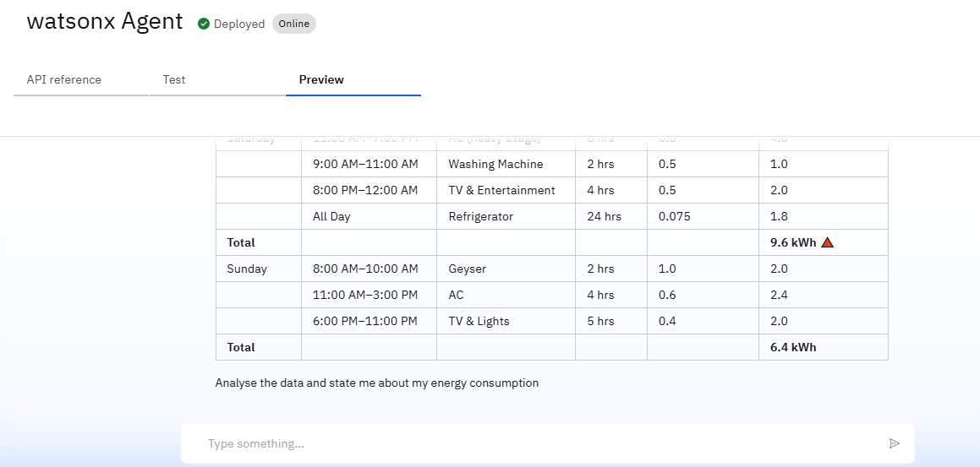
Results

Slide 10
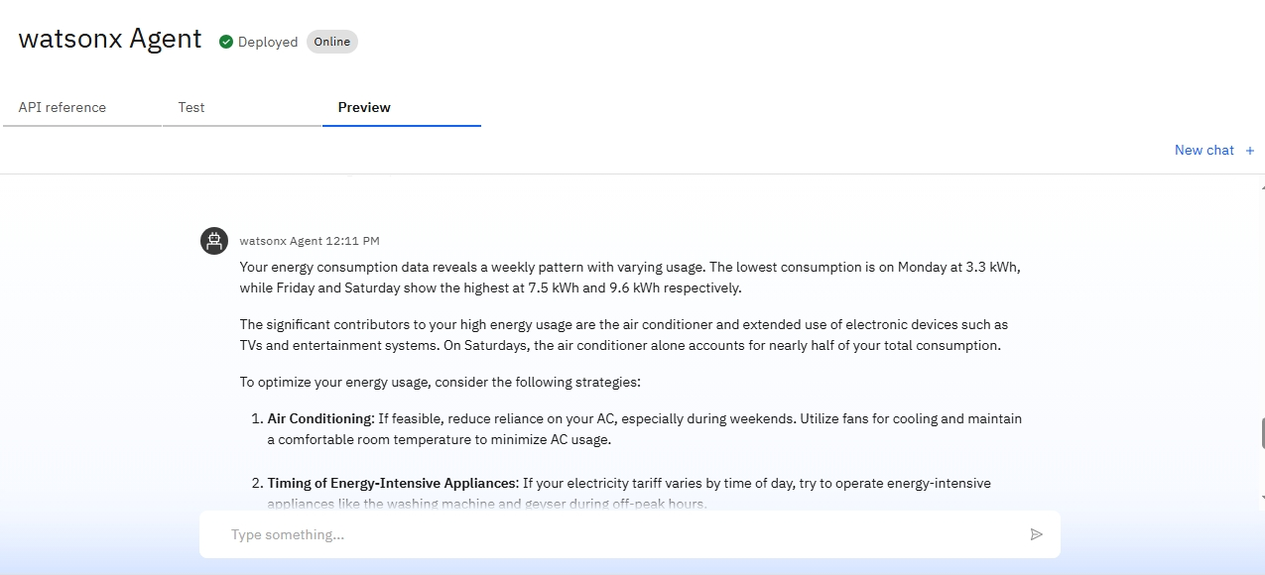
Results

Slide 11
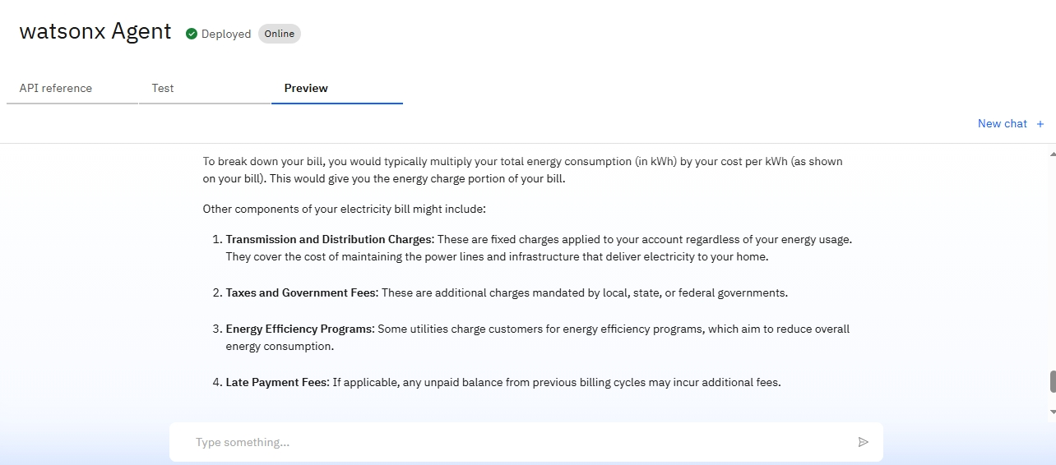
Results

Slide 12
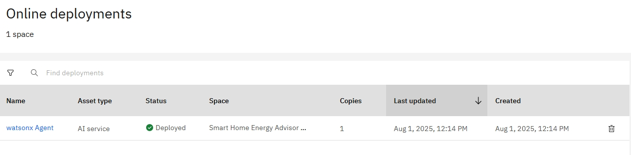
Results
Deployed AI Agent

Slide 13
Conclusion
Adaptive & Agentic Intelligence: It learns from user patterns through feedback loops, offering smarter recommendations over time.
Scalable Cloud-Driven Architecture: Built on IBM Cloud, the system supports future integrations with IoT devices and smart appliances for real-time control.
Data-Driven Insights for Households: Converts complex billing data into understandable, actionable insights to guide smart energy decisions.
Foundation for AI-Enhanced Home Automation: Positioned as a scalable prototype for integrating Agentic AI into real-time IoT-enabled energy control systems.

Slide 14
Future scope
IoT & Smart Appliance Sync
Eco Intelligence Dashboard
Predictive Bill Forecasting
Self-Diagnosing Agent Behavior
Behavioral Pattern Clustering
Energy Budgeting & Goal Tracking

Slide 15
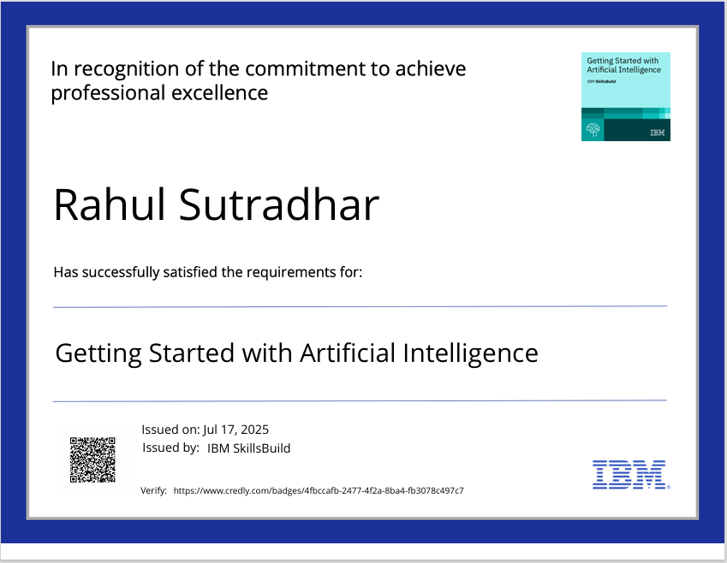
IBM Certifications

Slide 16
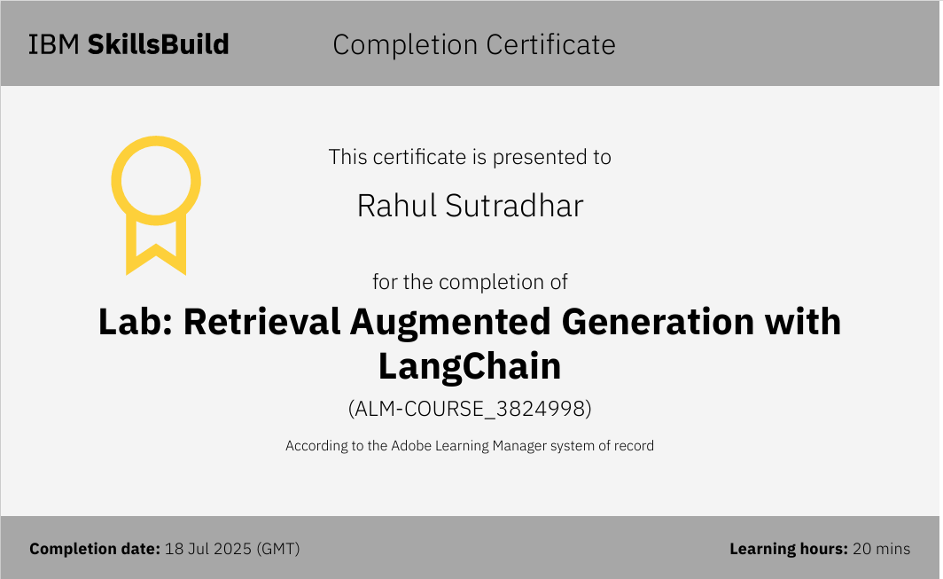

Slide 17
Git hub link :beingrahull/Smart-Home-Energy-Advisor-Agent

Slide 18
THANK YOU

